Slide 1
Your Club Name
Self NAVIGATION
Insert Date
https://www.youtube.com/watch?v=u9FjPUjqirY

Slide 2
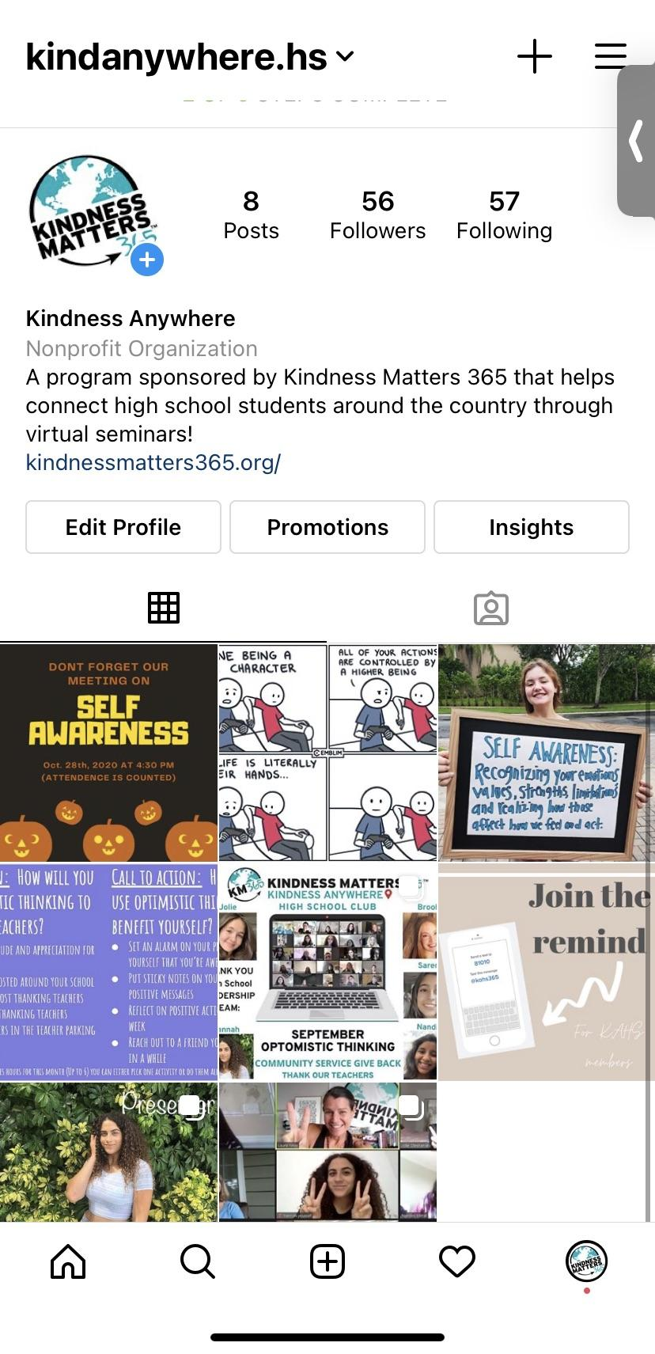
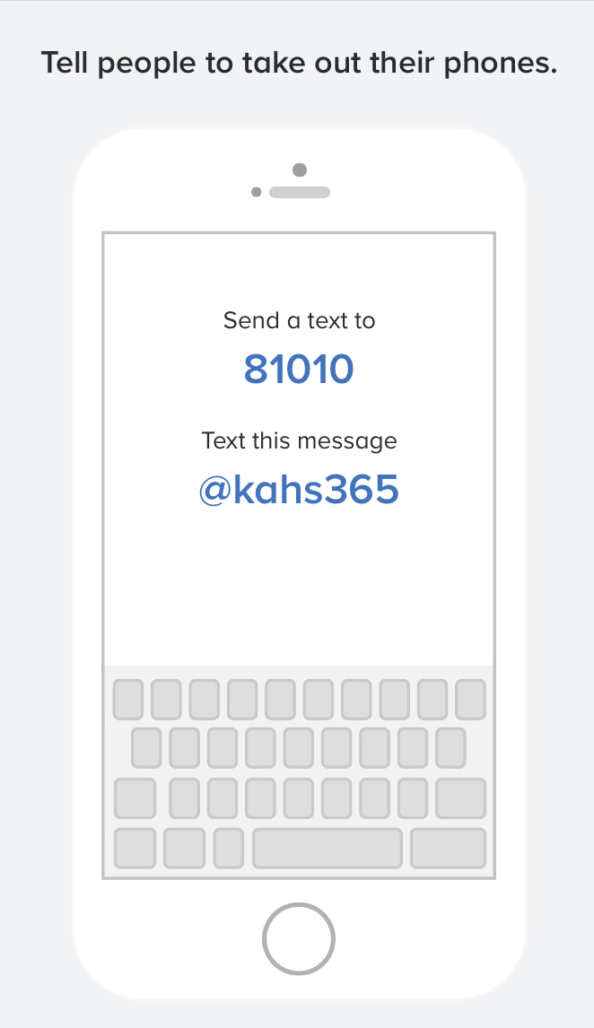
Sign Up for Remind
DM: SUCCESS (with your full name)
Absences (spots given to waitlist)
Follow our instagram:
@kindanywhere.hs

Slide 3
Member Share!! (30 seconds ea.)
WHO ARE YOU? :)
What grade are you in?
What state do you live in?
What school do you go to?
Fun Fact about yourself?
Why are you here?

Slide 4
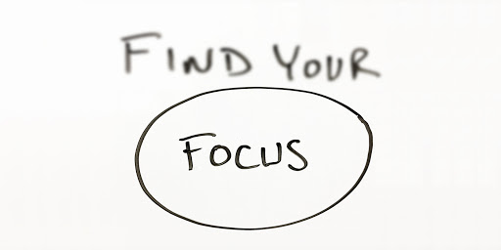
Find Your Focus:
Insert video link

Slide 5
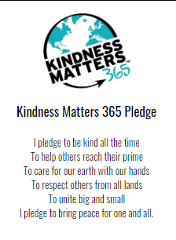
Spoken Word
Notes:
Read this together :)

Slide 6
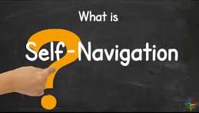
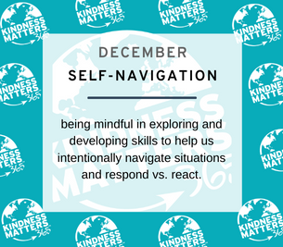
Topic of the Month:Self NAVIGATION
Notes:
KM365 defines Self-Navigation as: Being mindful in exploring and developing skills to help us intentionally navigate situations and RESPOND vs. REACT. How do you interpret that? Really explore RESPONDING vs. REACTING.

Slide 7
Personal stories

Slide 8
Call to action: How will you use self navigation to benefit yourself (and the community)?
Writing in a daily journal (gratitude journal)
Set short term & long term goals that are attainable
Create a personal mission statement
Employ compass like methodology
You can always use these techniques to help others around you :)
Compass like methodology:
how do you plan & execute?
Where are you going and what is your direction?
Why are you motivated?
What is the meaning of what you do?
Why are your limiting beliefs and internal barriers?
To receive your services hours for this month (Up to 6) you can either pick one activity or do them all :)!
Notes:
How we’re feeling now and steps we will take to accomplish that
To give back to others: write a list of reasons why you’re beautiful
Acknowledge at least 1 other person (november… thanksgiving)

Slide 9
Reflection & Group Photo
Insta: @kindanywhere.hs
Thank you for joining us! We can’t wait to see you next month :).
Notes:
What are you going to do this month for yourself to focus on Self Navigation (in chat).

